Slide 1
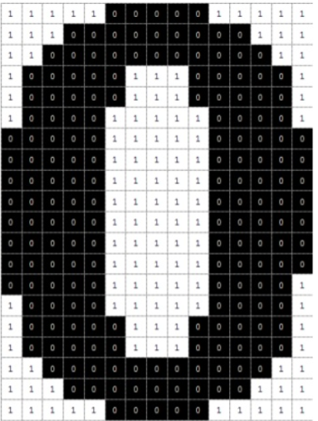

Slide 2
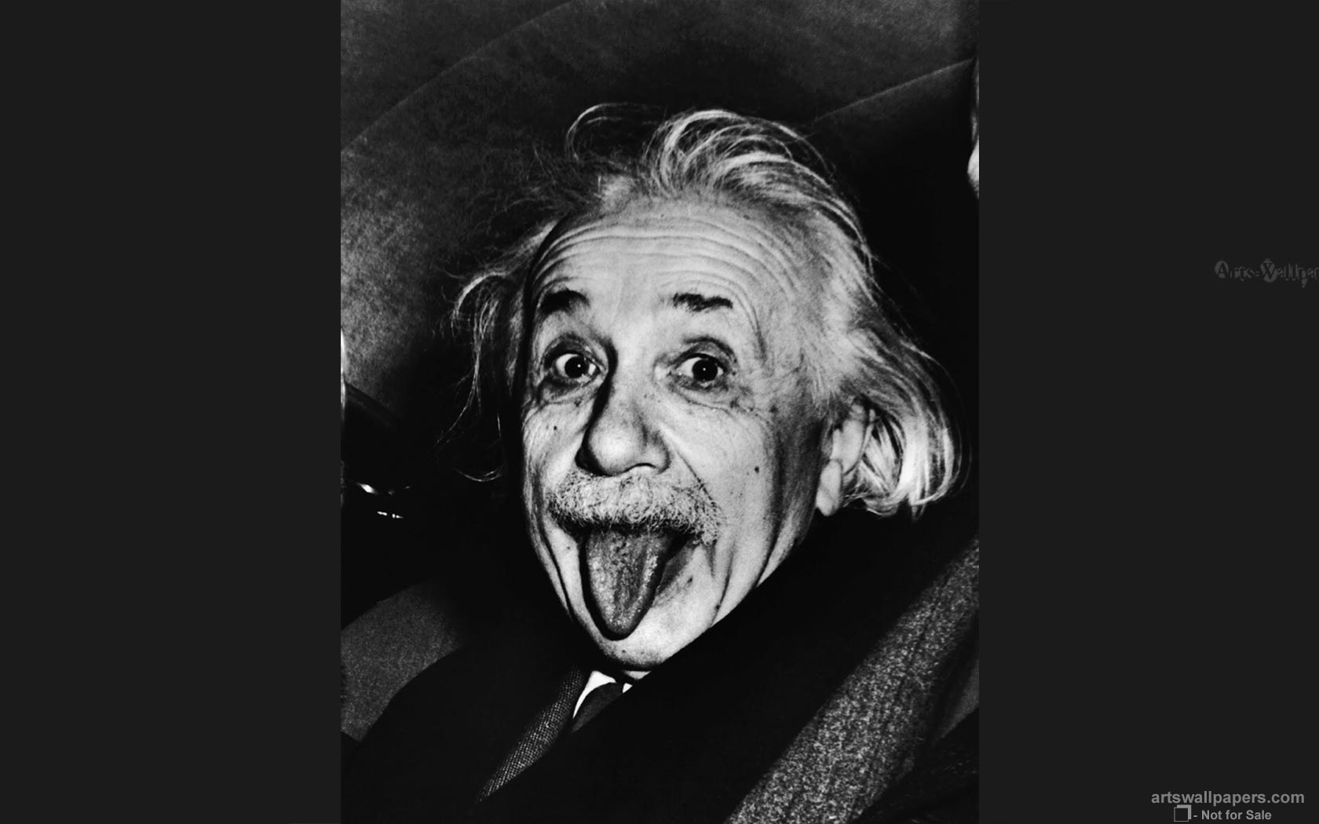

Slide 3
Convolutional Neural Network

Slide 4
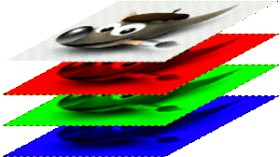

Slide 5
The Convolution layer

Slide 6
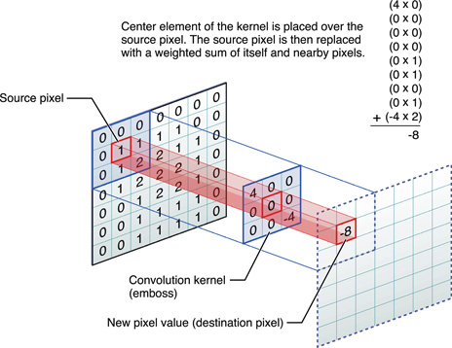

Slide 7
http://scs.ryerson.ca/~aharley/vis/conv/flat.html

Slide 8
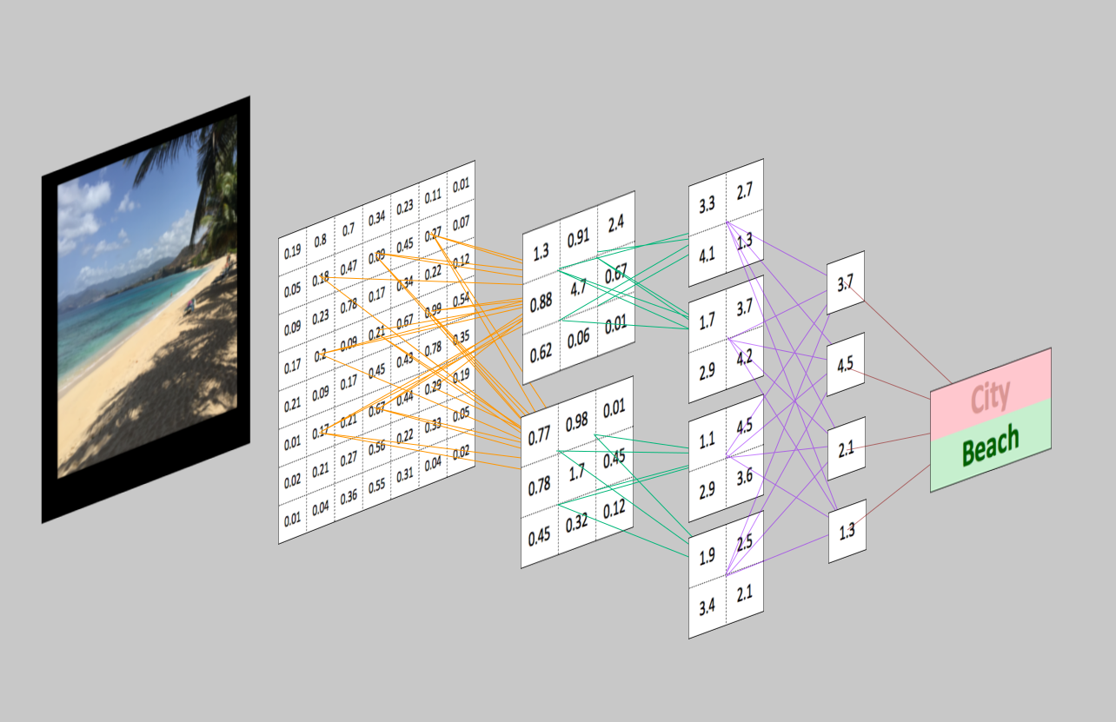

Slide 9
The Rectifier Unit Layer

Slide 10
The Pooling layer

Slide 11
Flattening

